Slide 1

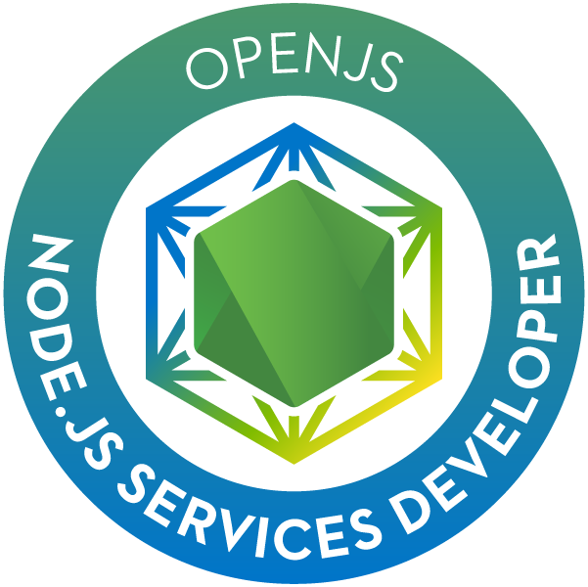

JSNSD
OpenJS Node.js services developer
REST API frameworks
September 2020

Slide 2

INDEX
Introduction
Express
Koa
FeathersJS
NestJS
Q&A

Slide 3




Introduction
While Node.js provides a fully fledged http module, that can be used to handle http requests and generate responses, the community has implemented several frameworks that ease its usage and provide additional features.
These frameworks are mostly aimed at building REST API services, but some of them also provide tooling to perform server-side rendering. You can think of them as Spring MVC/Boot, Play framework or Apache CXF REST. They’re usually very lightweight and can be extended through plugin systems – any developer can implement a plugin and have the rest of the world use it.
When deciding which framework to use, the following features must be evaluated:
Route management
Request management
Configuration
Extendibility
View engine support
Ecosystem
Maturity
Community

Slide 4
Introduction
General execution flow
Service
Request
object
Middleware
Headers
HTTP verb
Target URL
Body content
…
Middleware
Middleware
Framework runtime
Handler
Response
object
Headers
Status code
Response content
…

Slide 5
INDEX
Introduction
Express
Koa
FeathersJS
NestJS
Q&A

Slide 6



express
express
express is a minimal and flexible Node.js web application framework that
provides many features and is extensible through its middleware system.
To this day, it is almost considered the standard Node.js web middleware
and it is the most popular framework for Node.js. On top of that, it is very simple, minimalistic, scalable and flexible and has a low learning curve.
It supports rendering engines out of the box and is majorly focused on browsers.
Finally, it is fully customizable, making it suitable for almost any kind of service.
However, express requires a lot of boilerplate code– mainly route controllers – and maintenance becomes very complex if the project is not organized very clearly.
~50k stars
21.5M dls/w
Notes:
Provided simple appliocation
Best practices:
Use gzip compression.
Don’t use synchronous functions.
Do logging correctly (for debugging, use a special module like debug, for app activity use winston or bunyan).
Handle exceptions properly, using try-catch or promises.
Ensure your app automatically restarts by using a process manager or use an init system like systemd or upstart.
Run your app in a cluster. You can increase the performance of a Node.js app greatly by launching a cluster of processes (a cluster runs multiple instances of the app, distributing the load and tasks among the instances).
Cache request results, so that your app does not repeat the operation to serve the same request repeatedly.
Use a load balancer to run multiple instances of it and distribute the traffic, like Nginx or HAProxy.
Use a reverse proxy that performs supporting operations on the requests. It can handle error pages, compression, caching, serving files, and load balancing among other things.

Slide 7
INDEX
Introduction
Express
Koa
FeathersJS
NestJS
Q&A

Slide 8

Koa
Koa
Koa was built by the same team that designed and developed express.
It aims to be smaller and make web applications and APIs more enjoyable
to write.
Koa doesn’t bundle any middleware on its core, which is very small and
contains methods mostly common in all HTTP servers such as content negotiation, normalization and redirection among a few others.
In order to maximize performance, Koa uses promises through all its middlewares – ES7 is highly recommended in order to implement clean, readable code; for example, error management is much clearer using try/catch in combination with async/await.
Koa works as a middleware stack; this means the request can be manipulated as it goes downstream and the response can be filtered and enriched as it goes upstream.
In the other hand, it’s not as popular as express, and hence has a much smaller community.
~30k stars
803k dls/w

Slide 9
INDEX
Introduction
Express
Koa
FeathersJS
NestJS
Q&A

Slide 10

FeathersJS
FeathersJS
FeathersJS is a framework based on express which is focused on APIs and
real-time applications. It provides support for both JavaScript and TypeScript.
FeathersJS builds on top of the already rich Node.js ecosystem and doesn’t
aim to re-invent the wheel, instead, it attempts to provide features missing on the already existing tools by building on top of them. For example, it builds on top of express but provides support for ES7 async/await to improve code readability and maintenance.
It provides concepts such as services, transports, configuration functions and adapters to make application implementation easier by providing a clear separation of concerns for all the elements.
One of the best features of FeathersJS is that it works on the browser just like it works on the backend. However, I personally do not recommend using FeathersJS as a frontend framework as Angular, Vue or React are much better, specialized options.
~13k stars
66.8k dls/w

Slide 11
INDEX
Introduction
Express
Koa
FeathersJS
NestJS
Q&A

Slide 12

NestJS
NestJS
NestJS is a framework based on express which aims to provide a solid
foundation for application development by offering a modular and
flexible architecture which can be easily extended and customized.
Its module and service system are heavily inspired by Angular, making it easy for frontend developers to develop NestJS applications.
Its ecosystem is quite rich and offers a lot of third-party integrations ranging from databases to message brokers. This ecosystem ensures applications can be easily built using battle-tested components.
NestJS uses TypeScript out-of-the-box to provide strict typing and better object orientation features, but it also allows developers to use pure JavaScript.
~29k stars
434k dls/w

Slide 13
INDEX
Introduction
Express
Koa
FeathersJS
NestJS
Q&A

Slide 14

Q&A

Slide 15


Argentina
Belgium
Brazil
Chile
Colombia
France
España
Italy
Mexico
Perú
Portugal
United Kingdom
USA
Barcelona
Avda. Diagonal, 605 4a planta
08028 Barcelona
Tel.: 34 93 494 77 00
Mov: 34 692 288 378
www.everis.com

